Slide 1
Human Subjects Protection Program
2018 Metrics
Mariette Marsh
Director, Human Subjects Protection & Privacy Program

Slide 2
Reportable Events to Federal Agencies

Slide 3
Non Serious / Non Unanticipated Problems Reportable Events to HSPP
Reported events are reviewed by the IRB committee or single IRB chair based on level of risk.
Protocol deviations are the predominant reportable item submitted to the IRB during 2018.

Slide 4
Corrective Actions for
Reportable Incidents
Staff training was the main corrective action in response to reportable items during 2018.

Slide 5
Non-Committee Workload
4,214 submissions were received in 2018, compared to 3,796 submissions received in 2017.
Renewals and Amendments consistently represent the majority of Non-Committee submissions.

Slide 6
Committee Workload

Slide 7
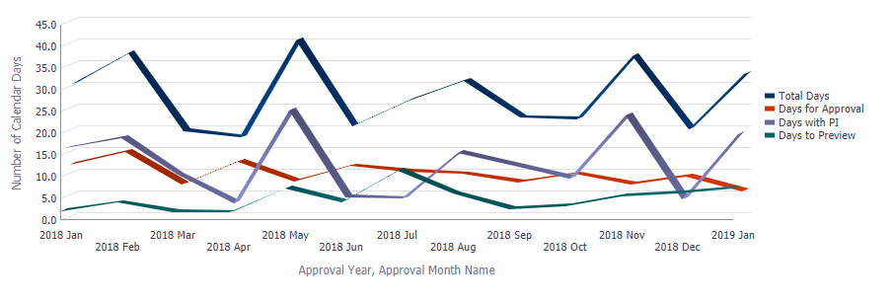
Full Committee Workload
Time Detail
Full Committee
Average Review Times (in days) By Month
Our goal is for average review times for the Full Committee to stay below 30 total days; this goal was met in 10 times during the 2018 calendar year.
Committee turnaround time is highly dependent on the time the submission sits back with the PI during a pre-review.
Around May 2018, COI and IRB integrated systems and IRB projects now are held pending resolution of COI requirements. There is no way to separate out IRB review times vs the time awaiting COI confirmation. Therefore it is unclear the impact on the total time to review.

Slide 8
Non-Committee Workload
Time Detail
Non Committee
Average Review Times (in days) By Month
Our goal is for average review times for Non-Committee work to stay below 14 total days.
Around May 2018, COI and IRB integrated systems and IRB projects now are held pending resolution of COI requirements. There is no way to separate out IRB review times vs the time awaiting COI confirmation. Therefore it is unclear the impact on the total time to review.

Slide 9
Banner Research Sites
*A project can occur at more than one Banner site.
*These two charts are not mutually exclusive.
As of Quarter 4:
519 projects used biological specimens
1200 projects used the EMR
Banner sites represent a significant portion of our research efforts.
The most common sites used by UA researchers are Banner-Tucson followed by UACC-North.

Slide 10
Biomedical vs Social & Behavioral Research
Historically, social & behavioral research (main campus) outnumbered biomedical research (Arizona Health Sciences Center) in terms of open studies.
In 2018, biomedical research has outpaced social and behavioral research.

