Slide 1
Human Subjects Protection Program
Christine Melton-Lopez
Director, Human Subjects Protection Program

Slide 2
Reportable Events to Federal Agencies

Slide 3
Non-Serious / Non-Unanticipated Problems Reportable Events to HSPP
Reported events are reviewed by the IRB committee or single IRB chair based on level of risk.
Protocol deviations remain the predominant reportable item submitted to the IRB in 2019. This remained true during the 4th quarter. Fourth quarter also saw a rise in deviations surrounding consenting issues.

Slide 4
2019 Non-Committee Workload
763 submissions were reviewed during Q4 of 2019.
Amendments represented the majority of Non-Committee submissions during Q4 of 2019.

Slide 5
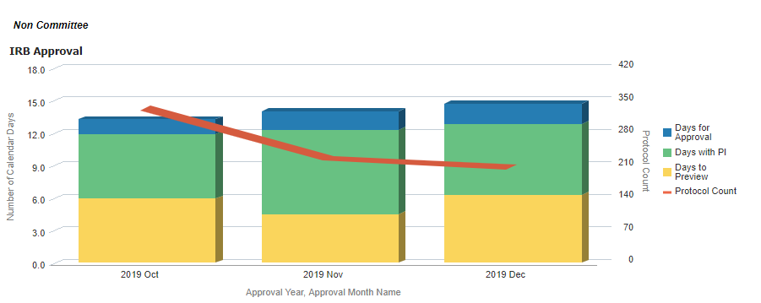
Non-Committee Workload
Time Detail Q4 2019
Non-Committee
Average Review Times (in days) By Month
Our goal is for average review times for Non-Committee work to stay below 14 total days. We were able to consistently meet this goal during quarter 4.

Slide 6
2019 Committee Workload
61 items were reviewed by the Full Committee during the fourth quarter of 2019.

Slide 7
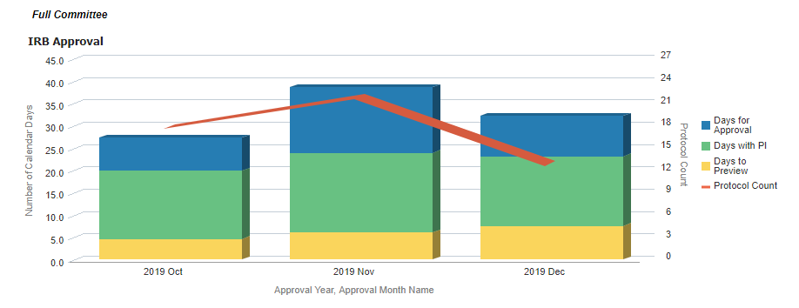
Full Committee Workload
Time Detail Q4 2019
Full Committee
Average Review Times (in days) By Month
Our goal is for average review times for the Full Committee to stay below 30 total days. We did not meet this mark during November and December as committee saw a rise in new project submissions.
Committee turnaround time is also highly dependent on the time the submission sits back with the PI during a pre-review.

Slide 8
IRB Training
Office Hours Starting in Q2 of 2019, we rolled out IRB “office hours” in place of form trainings. This is a time where investigators can come and bring questions, comments, or concerns for the IRB staff to address. We are still seeing this service underutilized by researchers.
Class presentations are typically conducted at the request of a professor. HSPP staff present on IRB topics such as the fundamentals, devices, or drugs.
Consultations are one-on-one meetings between HSPP staff and an investigator.
47 hours of training occurred over the fourth quarter of 2019
*Indicates number of presentations versus hours.

Slide 9
Banner Research Sites
*A project can occur at more than one Banner site.
*These two charts are not mutually exclusive.
As of Quarter 4:
1308 projects used biological specimens
565 projects used the electronic medical record
Banner sites represent a significant portion of our research efforts.
The most common sites used by UA researchers are Banner-Tucson followed by UACC-North.

